Slide 1

using SQL

Slide 2
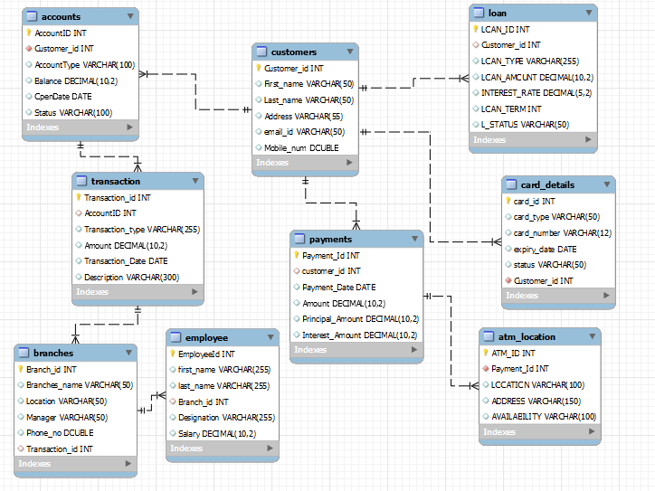
ERD -using Primary key and Foreign key

Slide 3
There are 9 different table in Bank Database
1.Employee
2.Customer detail
3.Branches
4.Accounts
5.Loan
6.Transaction
7.Atm_card location
8.Payments
9.Card detail

Slide 4
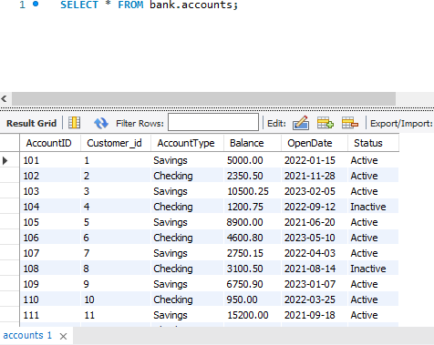
Analysis is done using Joins and ERD by making relationship using Primary and Foreign keys.
Accounts Table -

Slide 5
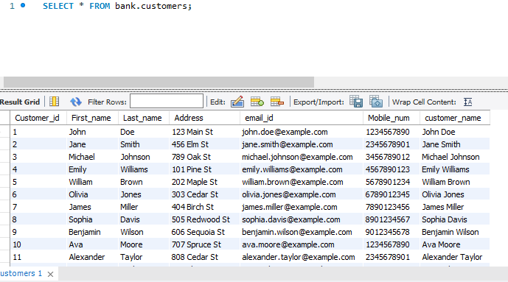
Customer Table-

Slide 6
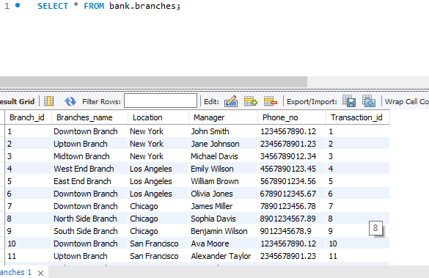
Branches Table-

Slide 7
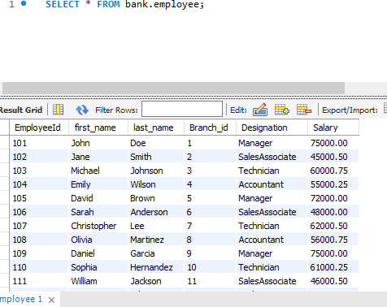
Employee Table -

Slide 8
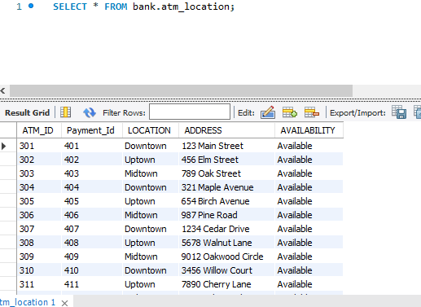
Atm Location Table -

Slide 9
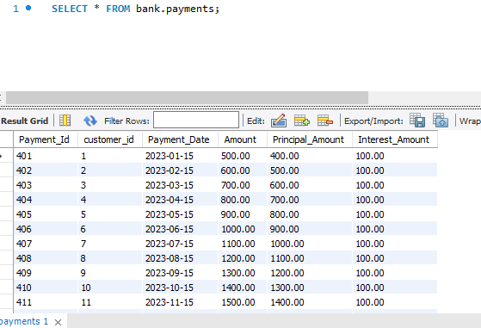
Payments Table -

Slide 10
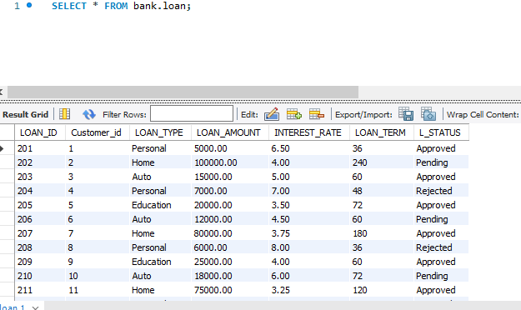
Loan Table -

Slide 11
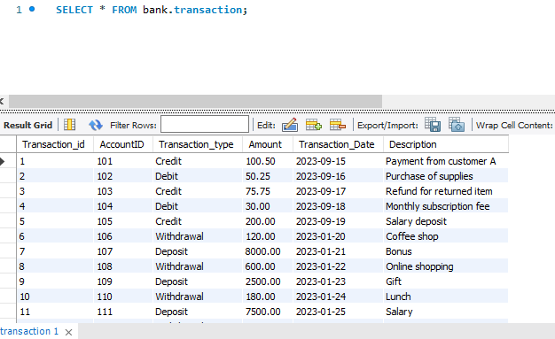
Transaction Table-

Slide 12
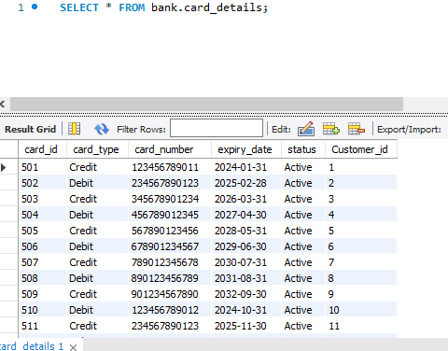
Card_Detail Table-

Slide 13
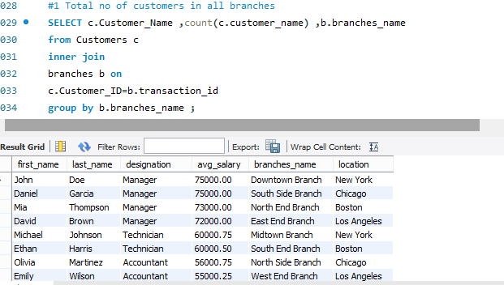

Slide 14
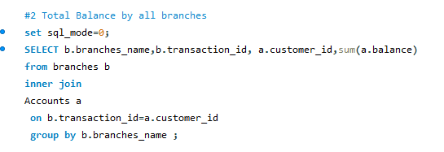
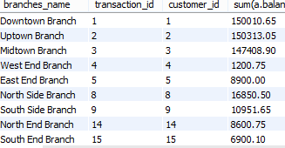

Slide 15

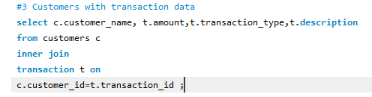

Slide 16
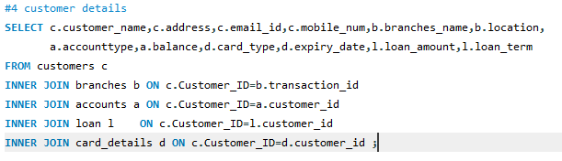
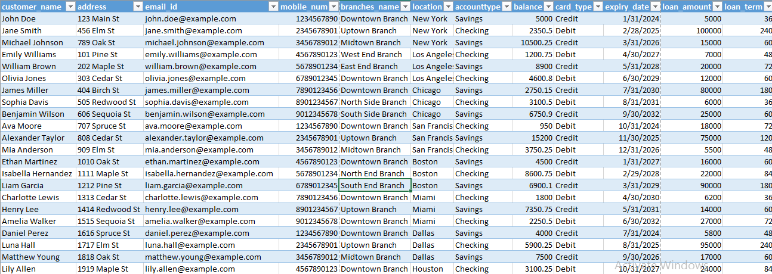

Slide 17
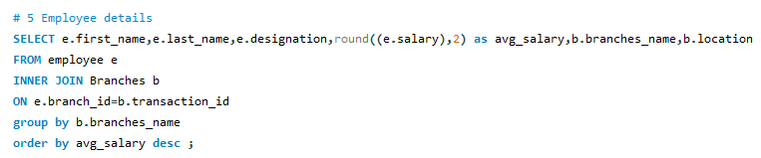
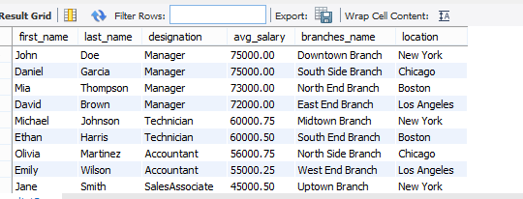

Slide 18
Summary -
Insights From Project-
Some key insights and functionalities of the project include:
Customer-Related Operations: The project enables the creation and management of customer accounts, card issuance, and loan applications.
Employee Management: It allows for employee information management, including their roles and assignments to specific branches.
ATM and Branch Information: The project keeps track of ATM locations and links them to the respective branches for effective branch management.
Transaction and Payment Tracking: Tracks all financial transactions and payments for customers, enabling financial analysis and reconciliation.
Loan Management: Monitors the status and details of loans, including loan origination, payments, and interest calculations.
Integration: The project integrates various tables to provide a comprehensive view of the bank's operations and enable efficient

Slide 19
Insights of Project-
The bank project in SQL is a robust system that can help streamline banking operations, improve customer service, and provide valuable insights into the bank's financial activities. It supports the core functions of a typical bank, such as customer management, financial transactions, and loan management, while also offering data for decision-making and reporting.

